Slide 1


Daily CSI
Spot the Differences
The One That Got Away
8th Grade Forensic Science
T. Trimpe 2008 http://sciencespot.net/

Slide 2
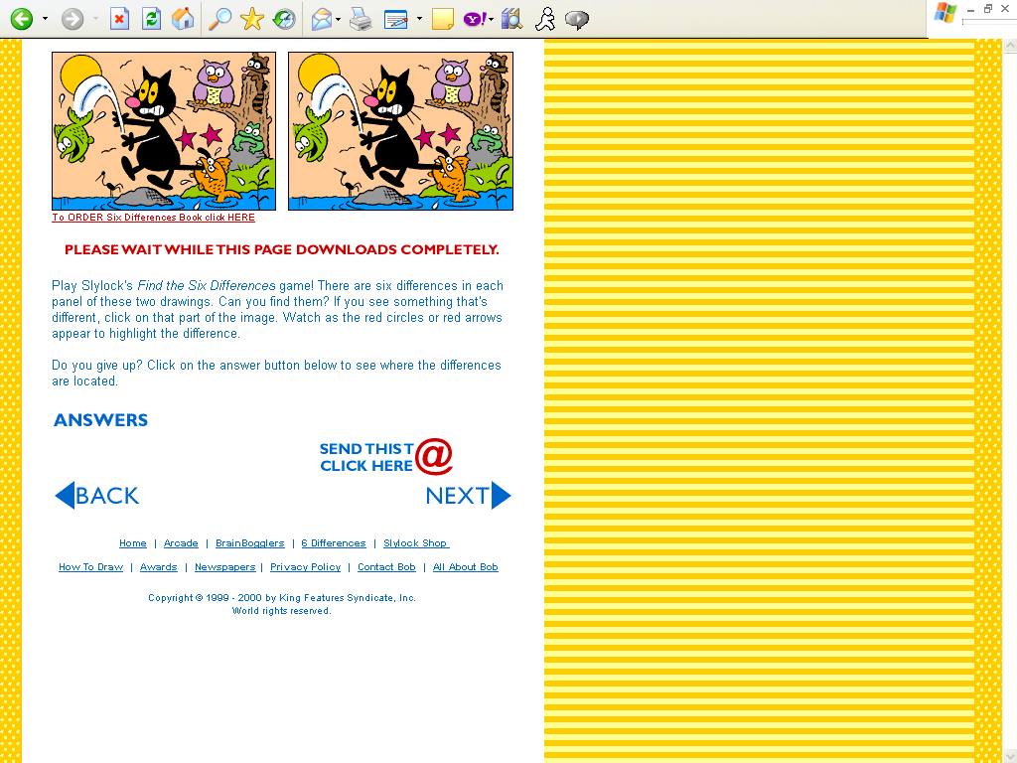
Find the 8 differences between the two pictures.
Source: http://www.slylockfox.com/arcade/6diff/index.html

Slide 3
The answers are …
Answers: Green fish’s fin, orange fish’s tooth, bird missing in sky,
frog’s head, missing branch, crane’s head, cat’s feet, cattail
Source: http://www.slylockfox.com/arcade/6diff/index.html

